Slide 1
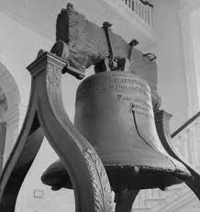
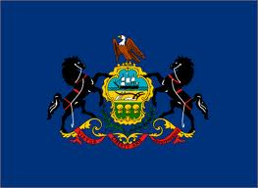
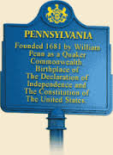
Pennsylvania History
Chapter 2: Understanding Our History: Early Inhabitants

Slide 2
Introduction to Chapter 2
It is estimated that Native Americans inhabited PA as long as 15,000 years ago
Europeans have only inhabited PA for 350 years
It was European settlers that disrupted the Native way of life, and it’s important to understand and respect this fact

Slide 3
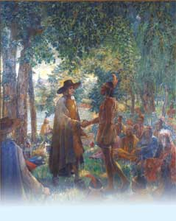
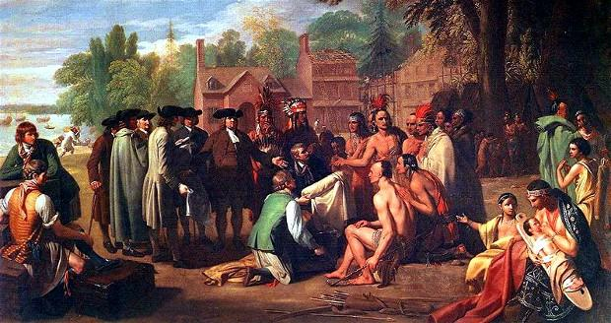
Lesson #5: Native American Inhabitants of Pennsylvania

Slide 4
Focus Questions
Who were the early Native American tribes in PA and where were they located in our region?
How did the Native American tribes in PA govern themselves?
What were the Native American homes and villages like?
How did the Native tribes live, travel, and worship in PA?
What were the main roles of men, women, and children of Native Americans?
What was the main contribution of Native American trails to modern society?

Slide 5
Key Words
Archaeologists
Clans
Council
Iroquois Confederacy
Tribal Council
Wigwam
Sweat Houses
Longhouse
Loincloths
Bartering
Exchange
Wampum belt
canoe

Slide 6
Their Arrival
Historians believe that Native tribes traveled by ice bridge from Asia more than 12,000 years ago
Natives probably didn’t realize they were traveling to a different continent when they did this
Over thousands of years they spread through North and South America

Slide 7
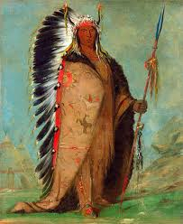
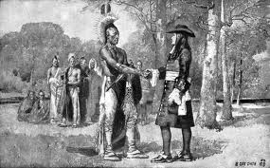
Their Arrival
By 1600 there were about 15,000 Native Americans living in what is now PA
When the first Explorers and Europeans arrived there were 2 large groups of natives
Iroquois
Algonquians
These groups were classified by language they spoke

Slide 8
Their Arrival
Algonquian Tribes
Shawnees
Nanticokes
Delawares
Iroquois
Iroqouis
Susquehannocks
Eries
Iroqouis
Eries
Nanticokes
Iroqouis
Susquehannocks
Delawares
Shawnees

Slide 9
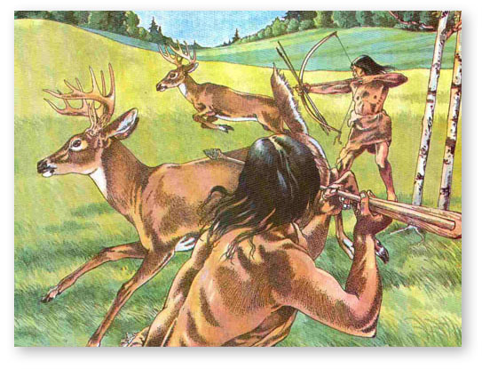
Their Environment
Pennsylvania plentiful with fresh air, food, water, and resources needed for clothing and shelter
Iroquois and Algonquian Tribes are both known as Woodland Indians due to their reliance on the forests

Slide 10
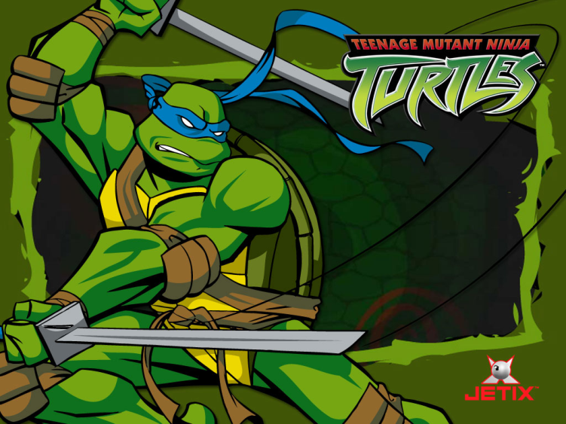
Government
Both Algonquian and Iroquois tribes lived in clans.
Each clan was named to represent an animal (turkey, wolf, turtle) that was thought to be an ancestor and protector of the clan

Slide 11
Algonquian Government
Women played a large role in the government
A council of men were chosen to run each clan
Women were responsible for the following…
Appointing men to these positions
Removing them if necessary
Assist in deciding matters involving war, tribal disputes, and food distribution

Slide 12
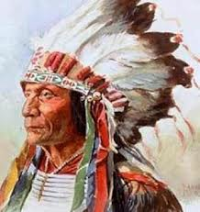
Algonquian Government
Algonquians were more independent, but less organized than the Iroquois.
Several clans made up a “Tribe” of Indians
Each tribe had a chief and several council members
The chief’s main roles were to lead the tribe in battle, in hunting, and settling disagreements

Slide 13
Iroquois Government
The Iroquois originally were 5 different tribes that fought with each other. In order to stop the fighting they came together as one.
The created the Iroquois Confederacy
Women from each tribe selected a chief to sit on a Tribal Council
One person from this council was selected to be the head chief
The main goal of this council was to keep the peace amongst the tribes.

Slide 14
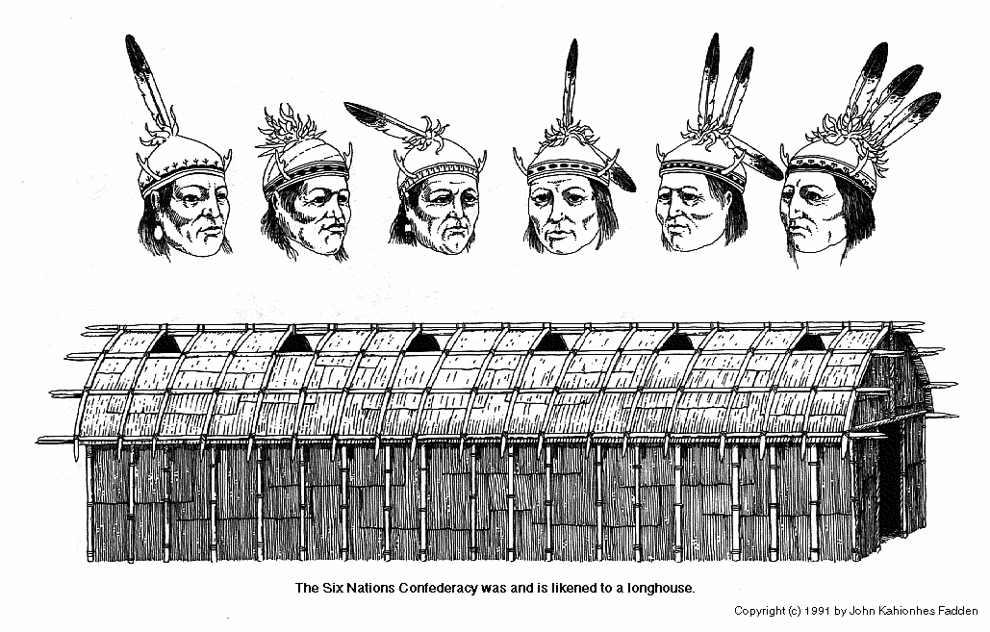
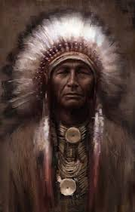
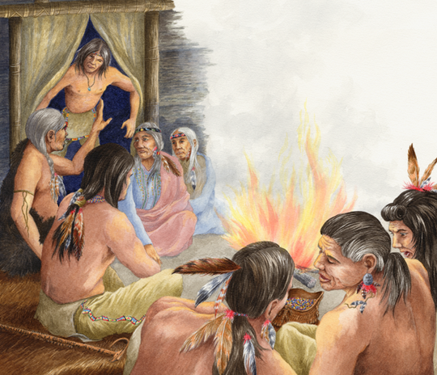

Slide 15
Judicial System
System was simple… Right and Wrong
Written language was not yet created so no rules written down
“Justice” meant having what you did wrong done to you
Example:
If you stole from someone; you had to give some of your possessions to the person you stole from
If you murdered someone; someone from the victims family got to kill you
In large disputes a council of tribesmen would meet to settle dispute

Slide 16
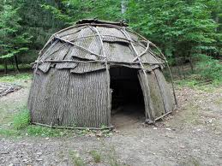
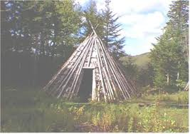
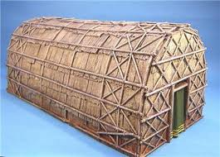
Native American Homes
Algonquians built small homes called wigwams for each family
These homes were either round, cone, or rectangular

Slide 17
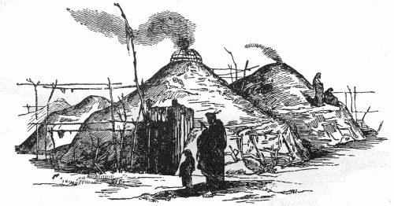
Native American Homes
Algonquians also built sweat houses
These were “health spas” created by pouring water over hot rocks
After sitting in the sweat house for a while they would run outside and jump in the stream or snow
This was one method of keeping clean

Slide 18
Native American Homes
Iroquois tribes built longhouses
Up to 20 families might share a single 20 by 100 foot long house
All relatives related to the mother and grandmother would live in these homes
Iroquois tribes would build villages surrounded by spiked fences to protect themselves from animals and enemies

Slide 19
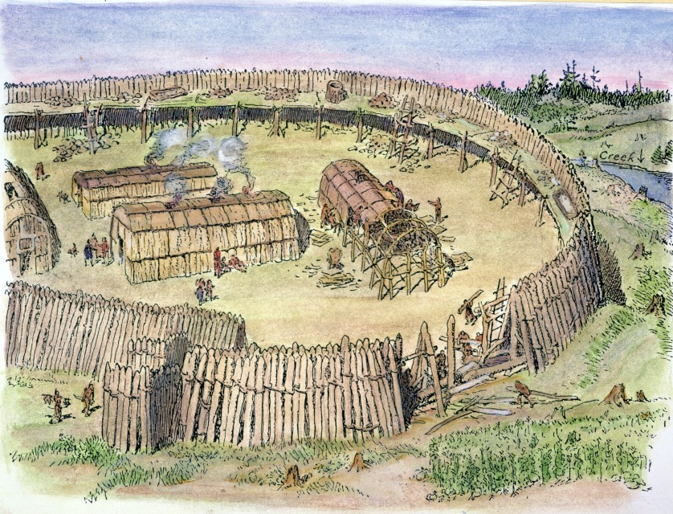

Slide 20
Native American Homes
When an Iroquois man married he moved in with his wife’s family but was not accepted into the “clan”
Their children would become part of the wife’s clan, but if he needed help he could not count on his children
In order to get help of any kind he would have to go back to his mother’s clan

Slide 21
Roles
Men and Women had very specific roles
Men
Hunt
Warriors
Tool Makers
Women
Plant Crops
Tended Crops
Gathered nuts and berries
Skinned Animals
Made Clothes
Prepared Meals

Slide 22
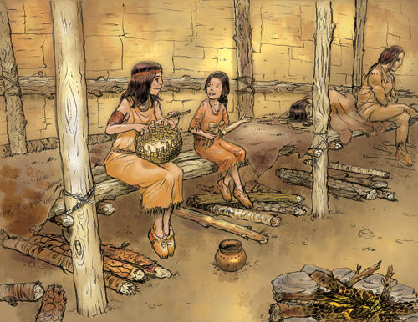
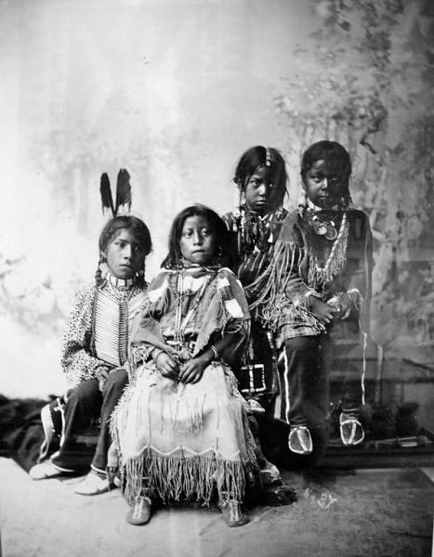
Roles
Children had roles as well…
Boys were expected to learn skills of men
Girls were expected to learn skills of women

Slide 23
Clothing
Deerskin was used as fabric
Deer pelts were brushed until the hair rotted off. The skin was then tanned into clothing called buckskin
Shirts, leggings, loincloths, skirts, and moccasins were all made of buckskin
Robes and blankets were made out of bear, beaver, or raccoon fur

Slide 24
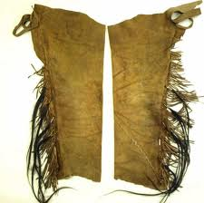
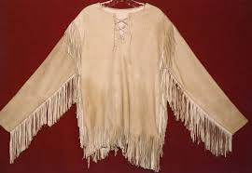
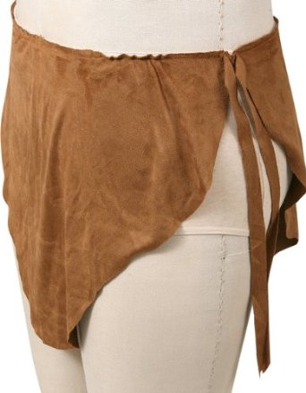
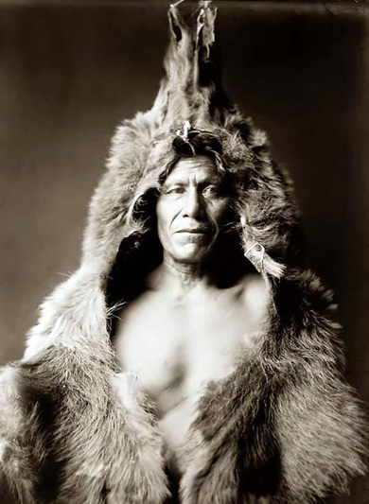
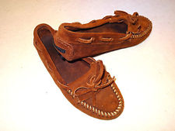

Slide 25
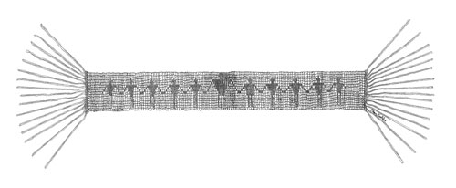
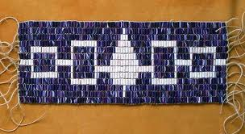
Money
Trading and bartering were the main ways of obtaining items they wanted or needed
Bartering is like trading
Natives would exchange furs for weapons and tools from Europeans
Wampum belts became very valuable once European settlers arrived. They were used as decorative items and symbolized peace

Slide 26
Transportation
When traveling by water the canoe was the method of choice
PA Indians traveled more by land than water
The natives created a very complex trail system all throughout the state
Different trails served different purposes: hunting, visiting, trading, and fighting
When lost they would check the moss which always grew on the northern side of trees

Slide 27
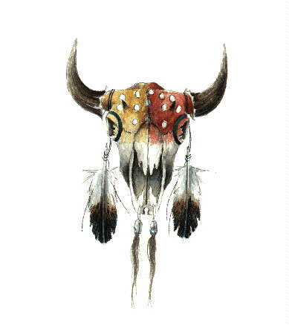
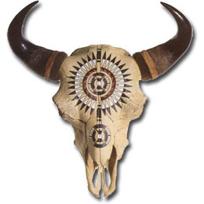
Religion
Natives worshipped nature and believed in one “Great Spirit”
Algonquians thought animal spirits were very powerful
They would find ways to respect animal remains in order to keep the “spirit” happy
Example: throw fish bones back in the water; pray to animal skulls

Slide 28
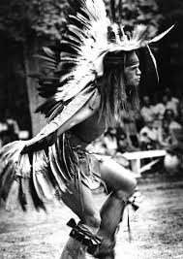
Religion
Iroquois religion actually shared similarities with Christianity
They acknowledged forces of good and evil
The “Master of Life” (Christian God) created the world and his evil brother (Christian Satan) constantly planned to destroy his creations
They also believed they could communicate with spirits through dreams

Slide 29
Answer the review questions on another piece of paper. If you do not finish this is homework.

Slide 30
Lesson #6: Early European Settlements in Pennsylvania

Slide 31
Focus Questions
Which European countries explored and settled in the Pennsylvania region?
Why was there so much conflict over the land in this region?
What kinds of cultural influences were left in the region?

Slide 32
Key Words
Conflict
Representatives
Retaliated
Wrangle

Slide 33
Key Places
Spain
Caribbean Sea
France
Canada
St. Lawrence River
Great Lakes
Mississippi River
Sweden
Holland
England
Hudson River
Delaware River
Jamestown, VA
Plymouth, MA

